Slide 1
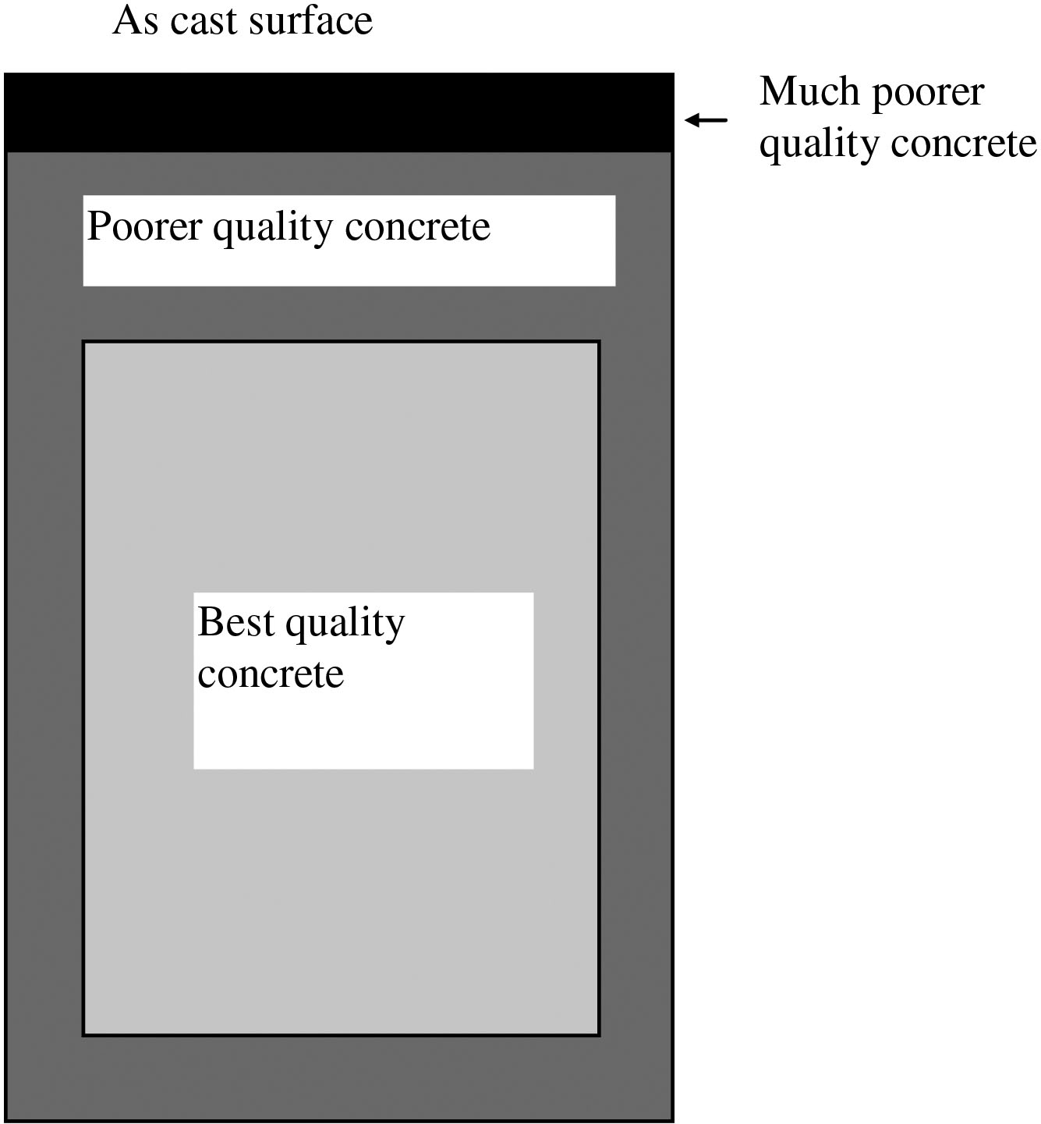
FIGURE 25.1 Cover Concrete
Copyright © 2016 Elsevier Ltd. All rights reserved.

Slide 2
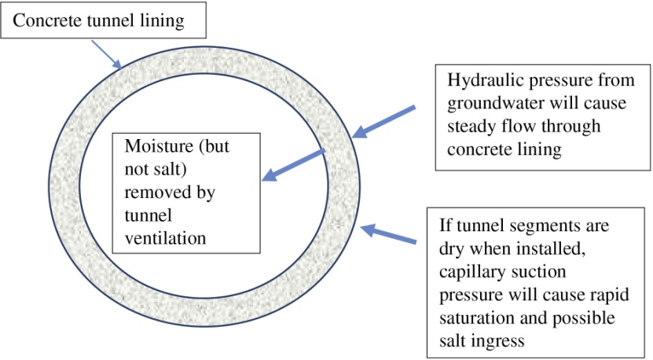
FIGURE 25.2 Schematic Diagram of Transport Processes in a Tunnel Lining
Copyright © 2016 Elsevier Ltd. All rights reserved.

Slide 3
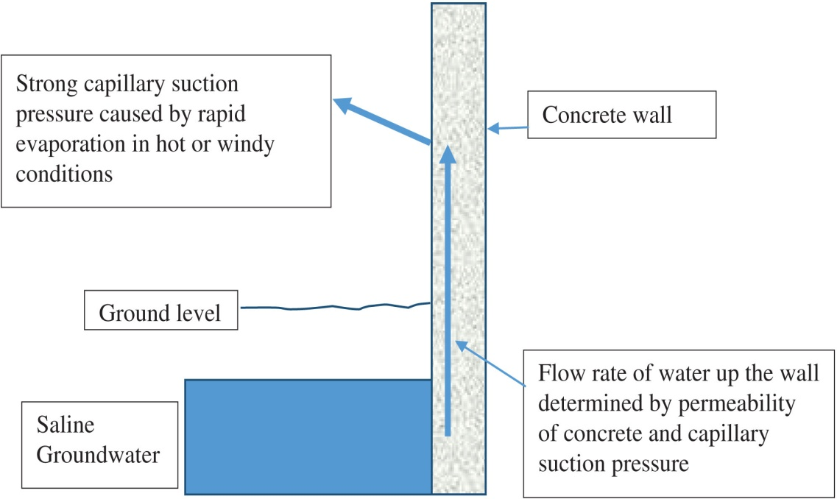
FIGURE 25.3 Schematic Diagram of Wicking Process
Copyright © 2016 Elsevier Ltd. All rights reserved.

Slide 4
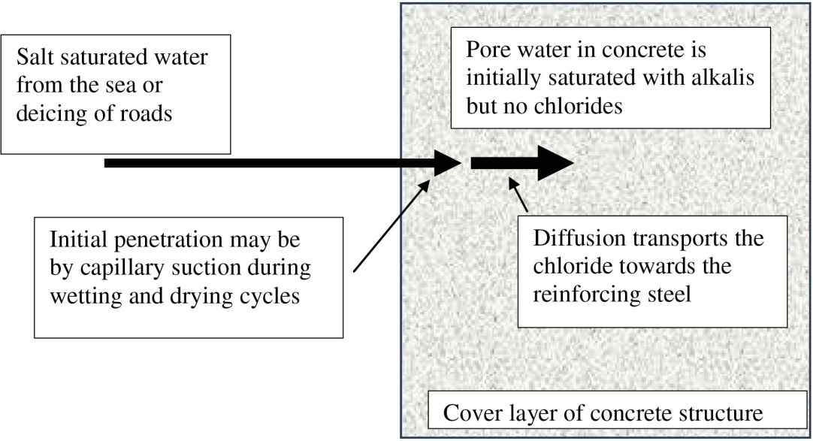
FIGURE 25.4 Schematic Diagram of Diffusion into Concrete Structure
Copyright © 2016 Elsevier Ltd. All rights reserved.

Slide 5
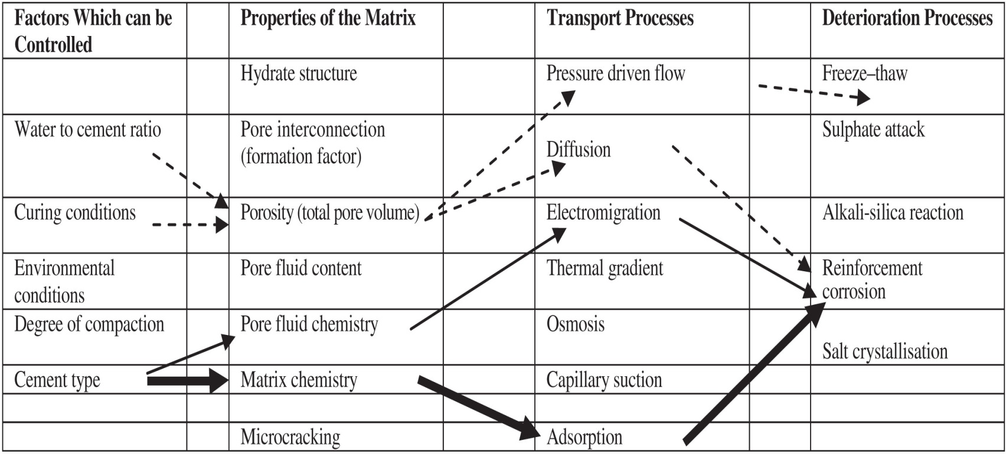
FIGURE 25.5 Factors Affecting Durability
Copyright © 2016 Elsevier Ltd. All rights reserved.

Slide 6
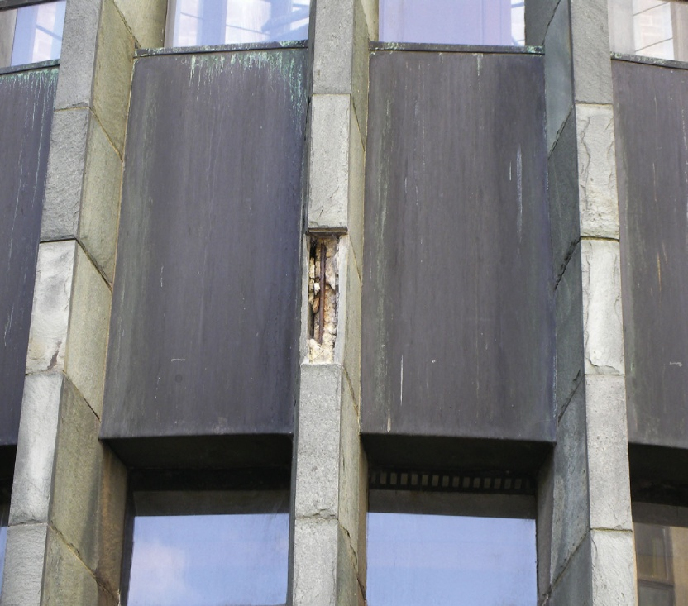
FIGURE 25.6 Carbonated Concrete on a 50-Year-Old Chapel at Coventry Cathedral
Copyright © 2016 Elsevier Ltd. All rights reserved.

Slide 7
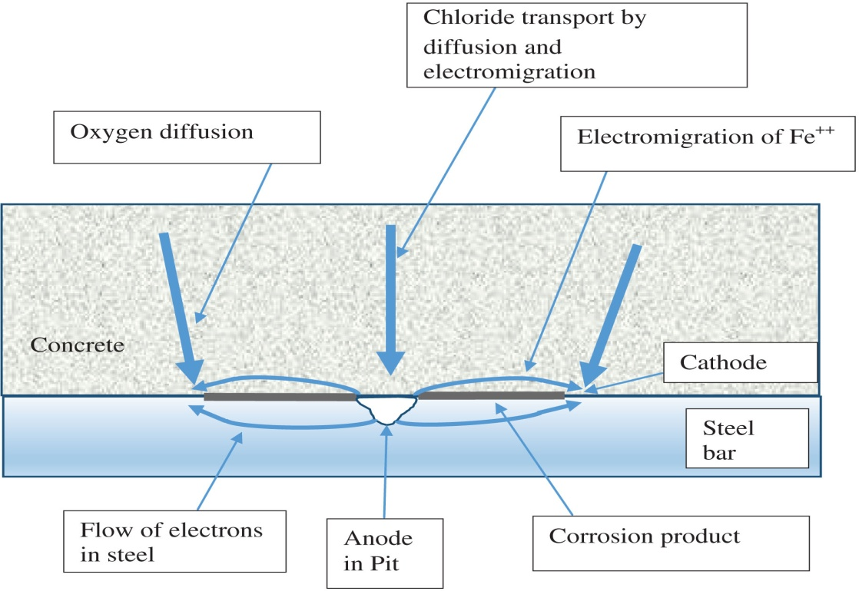
FIGURE 25.7 Pitting of Steel Reinforcement in Concrete
Copyright © 2016 Elsevier Ltd. All rights reserved.

Slide 8
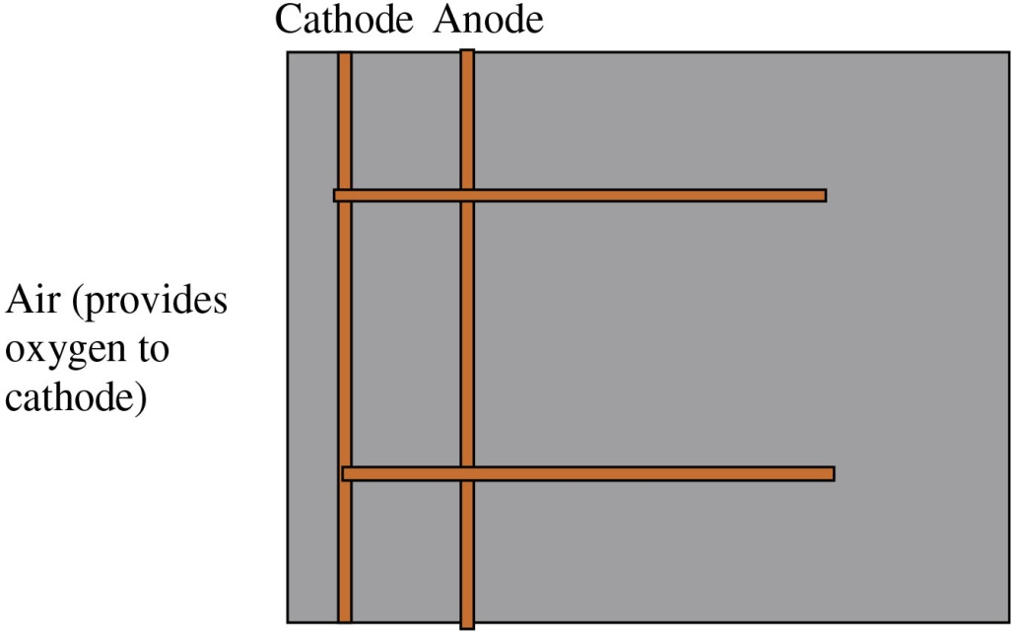
FIGURE 25.8 Anode and Cathode on Two Layers of Reinforcing Bars
Copyright © 2016 Elsevier Ltd. All rights reserved.

Slide 9
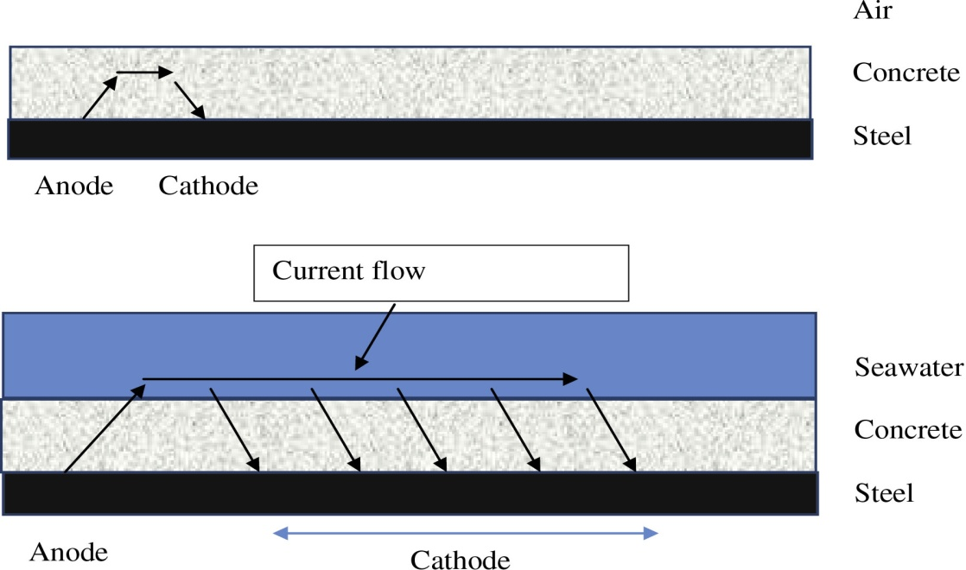
FIGURE 25.8 Anode and Cathode on Two Layers of Reinforcing Bars
Copyright © 2016 Elsevier Ltd. All rights reserved.

Slide 10
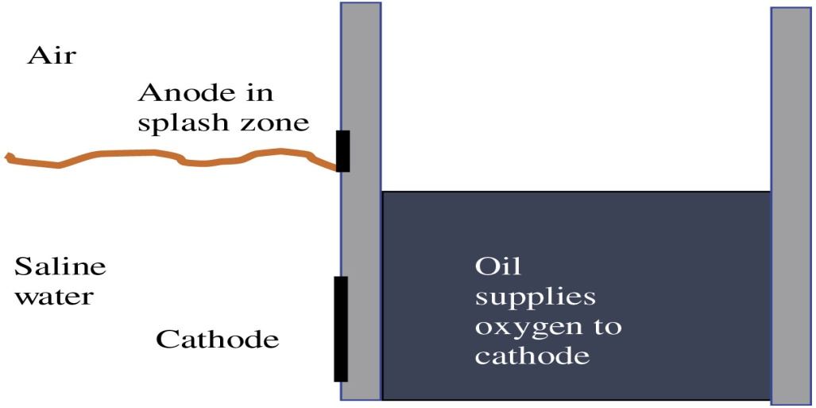
FIGURE 25.10 Corrosion in an Oil Retaining Structure
Copyright © 2016 Elsevier Ltd. All rights reserved.

Slide 11
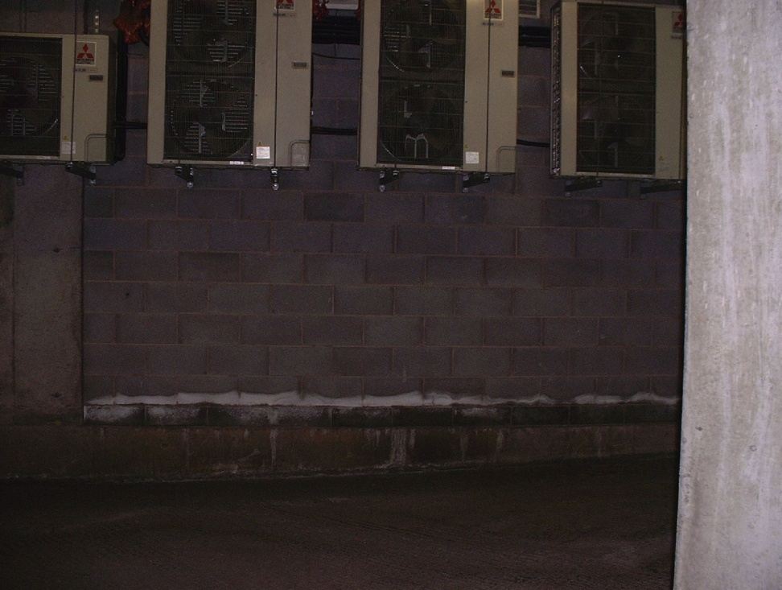
FIGURE 25.11 Salt Accumulation on Concrete Masonry Blocks in a Parking Garage
Copyright © 2016 Elsevier Ltd. All rights reserved.

